Slide 1
Text Mining ‘Project’ {
[Rap Lyrics Generator]
< Claudio Creis , Davide Convertino >
}

Slide 2
Content of the ‘Presentation’ {
01
02
03
Project Background
< LSTM model>
< Markov model>
Key Findings
< New opportunities >
Critical appraisal
< FUN THINGS >
}

Slide 3
01 {
[Project Background]
}

Slide 4
LSTM {
[How does it work?]
[long short-term memory networks]
[Cell state]
[Advantages to an RNN]
[How did we use it?]
[Built a larger model]
[Post-processing]
}
Notes:
Learns long term dependencies in a sequential form through deep learning
Information can be added or removed with through a layer that gives out a number between 0 and 1 (0 is no information and 1 is all the information)
LSTM makes small modifications on the data by simple addition or multiplication that flow through the cell states. Not changing all the data. With differentiable memory (with the cells)
B.
larger model using the sequential function adding neural networks ( LSTM) then a dropout function twice (dropout to make the model not see some data points so that the model is not overfitted and more reliable)
Output was words so we decided to join into a paragraph but decided to start doing lines in which we needed the markov model for:

Slide 5
The Markov Model{
[How does it work?]
The model predicts the probability that each letter or word occurs in a word or line
[How did we use it?]
We combined it with our LSTM model to make rhymes with the lines we were generating
}

Slide 6
02 {
[Key Findings]
}

Slide 7
1st Key Finding{
< Using two different Machine Learning Models to adapt to a more complex task such as generating lyrics with rhymes >
}
2nd Key Finding{
< We expect the lyrics generated by the two models to be very similar and almost indistinguishable from human created lyrics>
}

Slide 8
03 {
[Critical Appraisal and Relation to the topic]
}

Slide 9

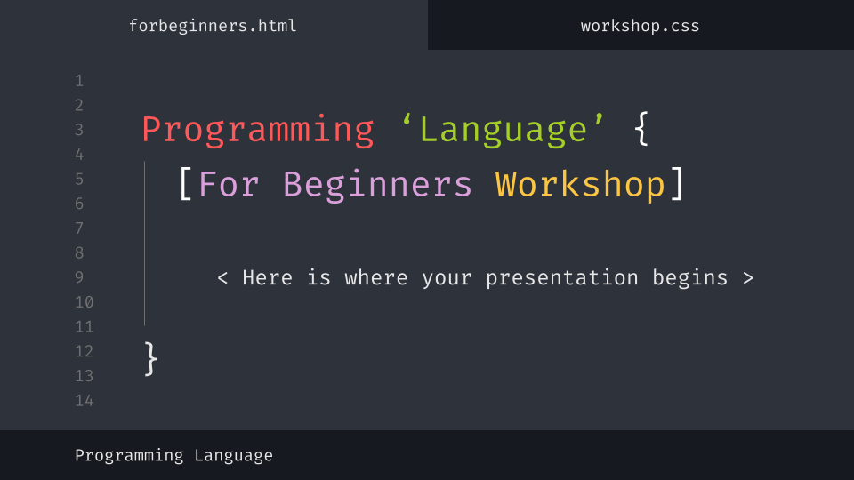
Kahoot Time {
Play with us to find out how our project could have been better
}

Slide 10
The‘Journey’ {
The rhyme problem
At the beginning we did not know how to make rhymes or where to put them in the code
Building a new model
We built a new model (RNN and Markov) and a new dataset
Model Problems
The model did not use the trained model to generate the Lyrics
Changing everything
Given how slow the model was and the problem we had, we changed the model again
}

Slide 11
Thank you for listening to us {
‘Do you have any questions?’
Claudio Creis,
Davide Convertino,
Amsterdam University College (AUC)
}

Slide 12
References
Dolphin, R. (2021, March 26). LSTM Networks | A Detailed Explanation. Medium. https://towardsdatascience.com/lstm-networks-a-detailed-explanation-8fae6aefc7f9
Markov Models for Text Analysis. (n.d.). Www.stat.purdue.edu. Retrieved June 2, 2022, from https://www.stat.purdue.edu/~mdw/CSOI/MarkovLab.html
Potash, P., Romanov, A., & Rumshisky, A. (2015). GhostWriter: Using an LSTM for Automatic Rap Lyric Generation (pp. 17–21). Association for Computational Linguistics. https://www.emnlp2015.org/proceedings/EMNLP/pdf/EMNLP221.pdf
Potash, P., Romanov, A., & Rumshisky, A. (2016). Evaluating Creative Language Generation: The Case of Rap Lyric Ghostwriting. https://arxiv.org/pdf/1612.03205.pdf

